Slide 1
SDET Training

Slide 2
Course Outline
Testing Principles & Quality Engineering
REST API
SQL
Selenium
Java Script
Performance Testing

Slide 3
SQL
Database concepts
Basic SQL
Implementation of Joins
Testing with SQL

Slide 4
What DBMS
A database management system (DBMS) or database system in short, is a software that can be used to create and manage databases.
DBMS lets users to create a database, store, manage, update/modify and retrieve data from that database by users or application programs.
Some examples of open source and commercial DBMS include MySQL, Oracle, PostgreSQL, SQL Server, Microsoft Access, MongoDB

Slide 5
What RDBMS
A Relational database management system (RDBMS) is a database management system (DBMS) that is based on the relational model as introduced by E. F. Codd

Slide 6
Areas to focus
Complete DBMS and RDBMS concepts
SQL vs NoSQL Database
DDL and DML
SQL Queries
Architecture
User Management
Data backups, pruning and recovery
Security
Concurrency

Slide 7
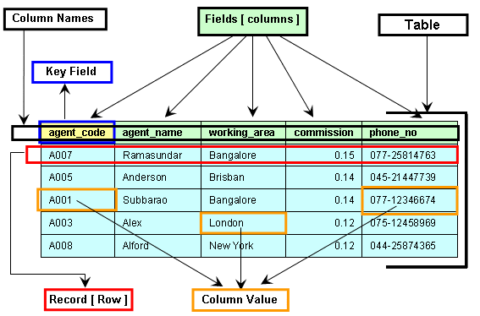
Table
Column
Field
Row or Record
Value

Slide 8
SQL Constrains
Constraints are the rules enforced on data columns on a table. These are used to limit the type of data that can go into a table. This ensures the accuracy and reliability of the data in the database.

Slide 9
SQL Constrains contd..
Most commonly used constraints:
NOT NULL Constraint − Ensures that a column cannot have a NULL value.
DEFAULT Constraint − Provides a default value for a column when none is specified.
UNIQUE Constraint − Ensures that all the values in a column are different.
PRIMARY Key − Uniquely identifies each row/record in a database table.
FOREIGN Key − Uniquely identifies a row/record in any another database table.
CHECK Constraint − The CHECK constraint ensures that all values in a column satisfy certain conditions.
INDEX − Used to create and retrieve data from the database very quickly.

Slide 10
Database Normalization
Database normalization is the process of efficiently organizing data in a database. There are two reasons of this normalization process −
Eliminating redundant data, for example, storing the same data in more than one table.
Ensuring data dependencies make sense.
Normalizations Forms
1NF
2NF
3NF
4NF, etc..

Slide 11
SQL Commands
DDL (Data Definition Language)
CREATE
ALTER
DROP
DML (Data Manipulation Language)
SELECT
INSERT
UPDATE
DELETE
DCL (Data Control Language)
GRANT
REVOKE

Slide 12
DDL Commands
CREATE:
CREATE DATABASE testdb;
CREATE TABLE Persons ( PersonID int, LastName varchar(255), FirstName varchar(255), Address varchar(255), City varchar(255) );

Slide 13
DDL Commands
ALTER:
ALTER TABLE table_name ADD column_name datatype;
ALTER TABLE table_name DROP COLUMN column_name;

Slide 14
DDL Commands
DROP:
DROP DATABASE database_name;
DROP TABLE table_name;

Slide 15
DML Commands
DML (Data Manipulation Language)
SELECT
SELECT * FROM table_name;
INSERT
INSERT INTO table_name (column1, column2, column3, ...) VALUES (value1, value2, value3, ...);
UPDATE
UPDATE table_name SET column1 = value1, column2 = value2, ... WHERE condition;
DELETE
DELETE FROM table_name WHERE condition;

Slide 16
DCL Commands
GRANT
grant insert, select on accounts to Ram
REVOKE
revoke insert, select on accounts to Ram

Slide 17
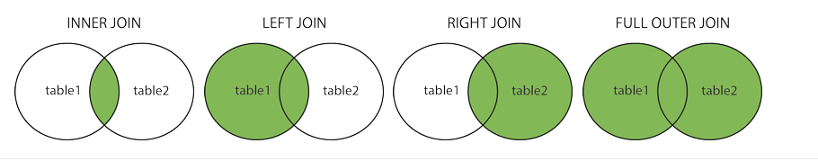
Joins
A JOIN clause is used to combine rows from two or more tables, based on a related column between them.
Types of Joins
Inner Join
Left Outer Join
Right Outer Join
Full Outer Join

Slide 18
Join Commands
Inner Join
SELECT column_name(s) FROM table1 INNER JOIN table2 ON table1.column_name = table2.column_name;
Left Join
SELECT column_name(s) FROM table1 LEFT JOIN table2 ON table1.column_name = table2.column_name;INSERT
Right Join
SELECT column_name(s) FROM table1 RIGHT JOIN table2 ON table1.column_name = table2.column_name;
Full Join
SELECT column_name(s) FROM table1 FULL OUTER JOIN table2 ON table1.column_name = table2.column_name WHERE condition;

Slide 19
Testing with SQL

Slide 20


